Slide 1

Extracting Biological Mechanisms From PubMed Titles for Information Retrieval
A Title Based Approach Using Biomolecular Event Extraction

Slide 2
Reviewing Motivation and Purpose
Goal is to use best model or ensemble of models to produce an inference and information retrieval system for biomedical researchers.
This will likely be done in the form of producing a knowledge graph with the information extracted from literature.
The knowledge graph would be used with search and inference algorithms to answer questions about genes, diseases, proteins, pathways, targets, or processes.
However, moving forward we are investigating if a PLM can serve the role of a knowledge graph.
If we train a language model to recognize biological mechanisms in literature, could we eventually also have a model that takes biological research questions and produces a nicely summarized answer as output.
If possible, this solution would turn out to be something like a biological mechanism focused Chat GPT.

Slide 3
Why Event Extraction from Titles
Title is very often the most concise summary of a papers key mechanistic contributions to the field.
The title is naturally the best place to start for information seeking.
If there are critical gaps in the mechanistic information, the abstract can be extracted from as a second step once some base information is obtained.
Event extraction allows for a flexible information filling template to be developed that has a more specific meaning than the relations or lone entities extracted with RE or NER.
This biological mechanism event extraction template extracts the information in a form that would be more concise and meaningful to researchers in the field.
Using titles makes it faster and less labor intensive to make a quality event extraction dataset.

Slide 4
Title Event Extraction Template
The biological mechanisms template consists of four arguments and a regulation related verb.
Arg 1: Best described as the initiator, usually is a gene, protein, RNA, small molecule, or a condition
Arg 2: Best described as the affected entity or process
Arg 3: Best described as the context
Arg 4: Is the target, often another gene, RNA, protein, or pathway.
Arg 5 was removed from template, since it can be more reliably extracted as a second extraction task once Arg 4 is identified.
Regulation verbs express what type of regulation is being performed by the biological mechanism described.
Examples are promotes, inhibits, down-regulates, reduces, and degrades

Slide 5
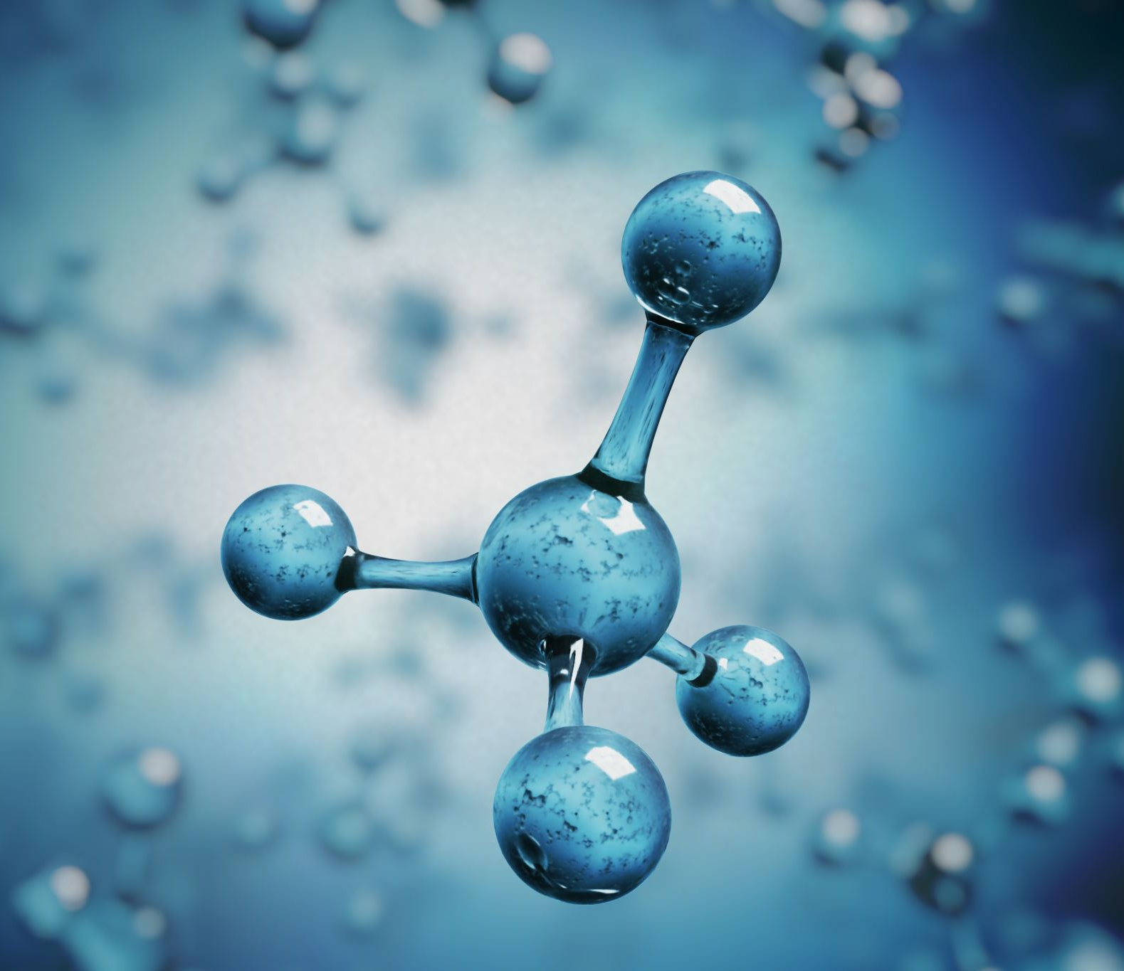
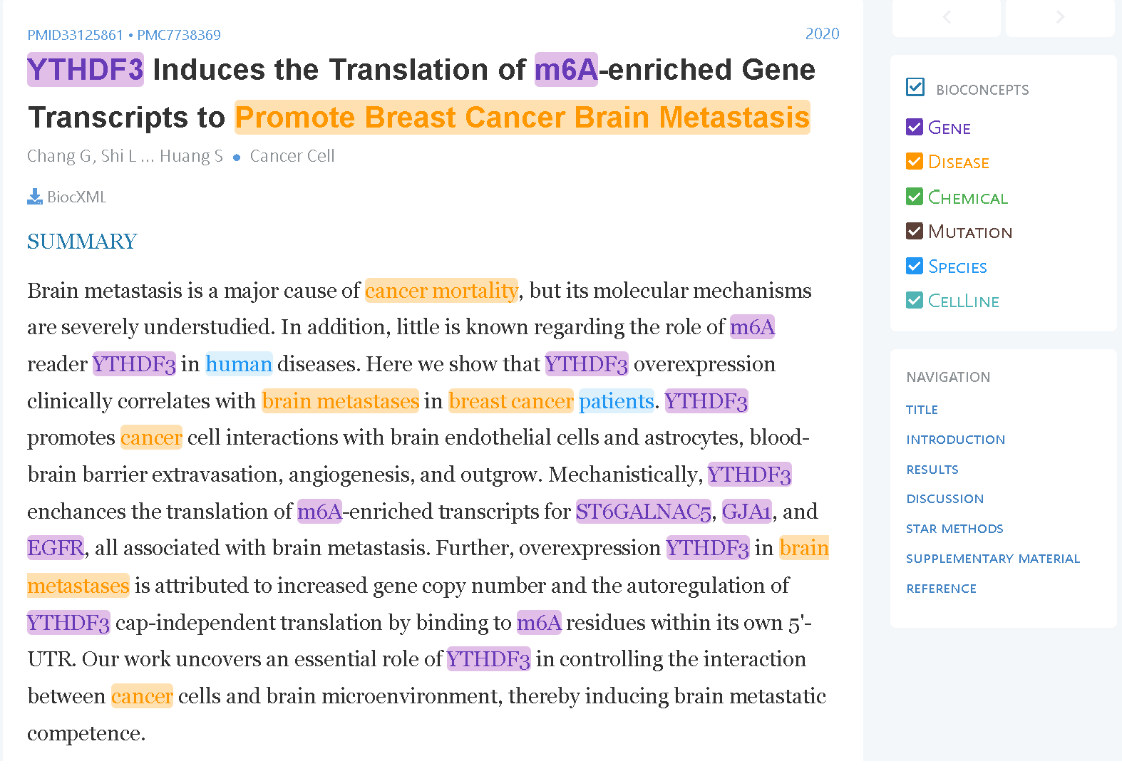
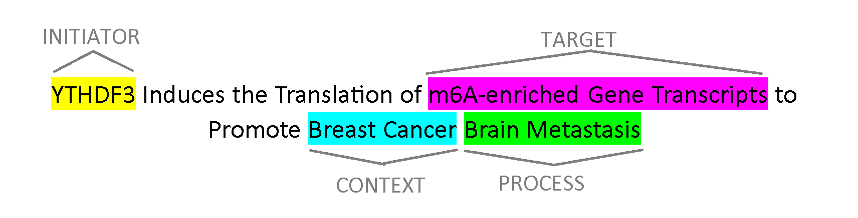
Comparison of Title EE and Other Current Methods
PubTator is a currently available tool on the NIH website for Biological IE
Here is a comparison of the Title based EE with PubTator’s extraction from the abstract on the same PubMed Article.

Slide 6
Model Architecture
The model being employed here is based on BERT, and also uses an algorithm called dynamic span graphs in order to facilitate information extraction.
The dynamic span graph algorithm was originally from the DYGIE paper produced from The Allen Institute for AI, (Wadden et al, 2019).
This first DYGIE paper was extended with DYGIE++ that improved the span, graph algorithm, and used BERT to produce the span embeddings instead of ELMO and GLOVE.
DYGIE++ first uses BERT to produce embeddings for all spans, and these embeddings are then used to greedily produce a fully connected graph of all potentially relevant entity spans.
The last component of DYGIE++ is a fully-connected graph pruning network that is trained to prune the entities out of the graph that do not fit a certain argument, or do not match the current regulation verb being extracted.
This greedy approach works well for obtaining high accuracy on title based event extraction since there are not all that many potential entity spans that can be formed from a single title.

Slide 7
Supervised fine-tuning of BERT and Training of the Graph Pruner Network
Used 400 carefully annotated titles
Performed evaluations with 5-fold cross validation
Tokenized the titles by splitting on spaces and punctuation
The baseline model used SciBERT PLM
Experimented with three other BERT PLMs
PubMed BERT base (12 attention layers) trained on PubMed abstracts
Clinical PubMed BERT base (12 attention layers) trained on clinical notes
PubMed BERT large (24 attention layers) trained on full PubMed articles
All trained on masked language modeling pretraining tasks

Slide 8
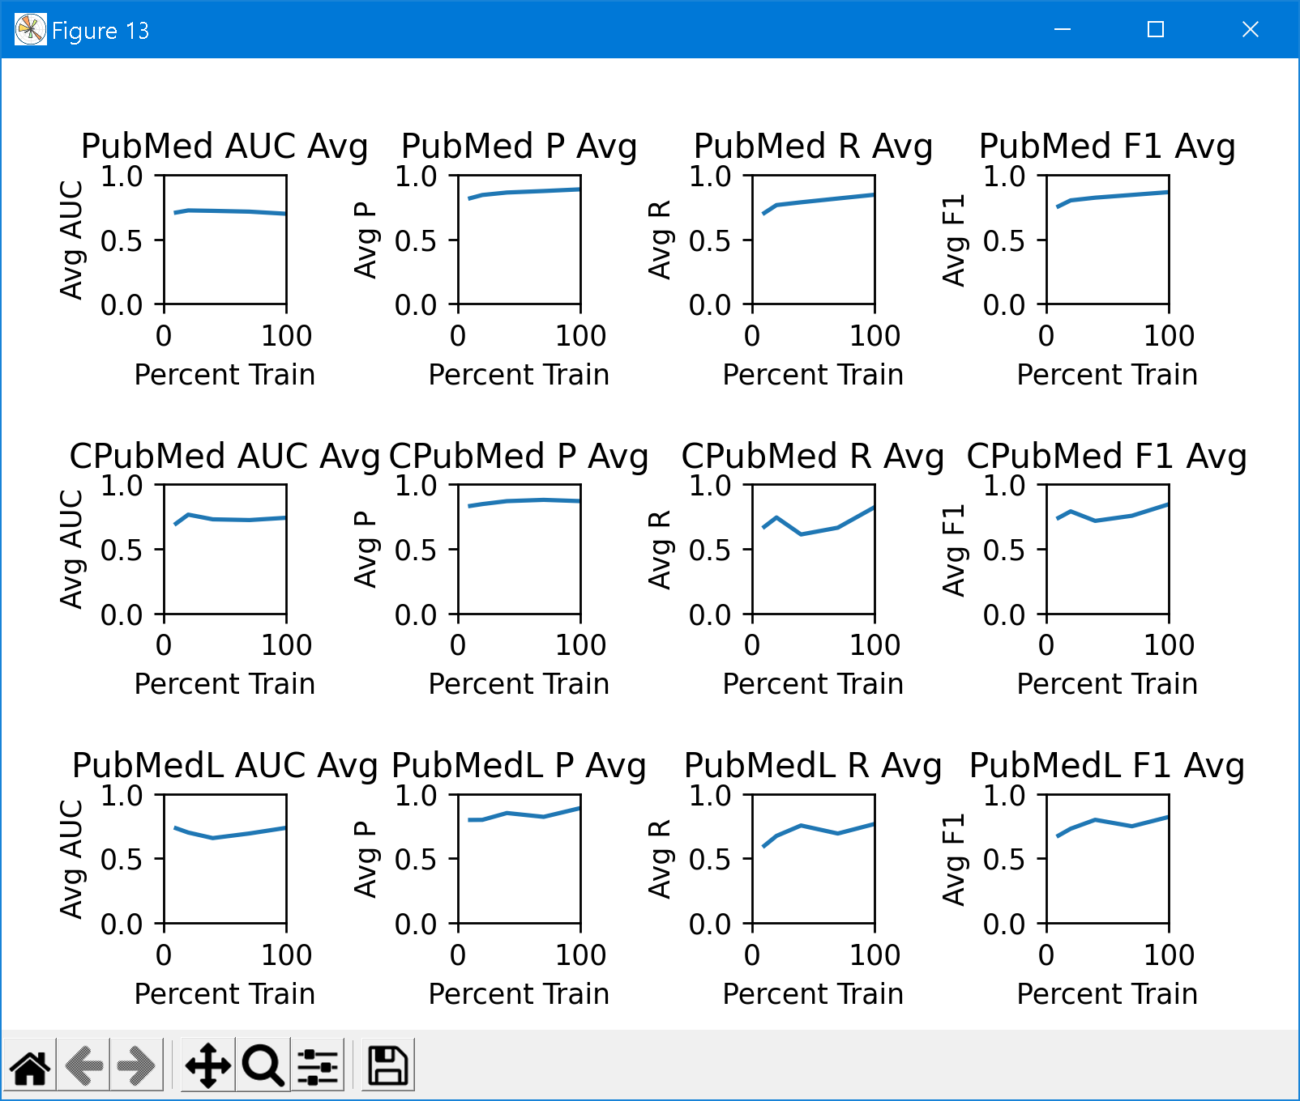
Experimenting with Variation of Available Training Titles used During 5-fold CV
Each fold of training had a maximum of 240 titles available
10 % used 24 titles, and 100% used 240 per fold
Wanted to see if over all performance trending slightly upward when using more training examples.

Slide 9
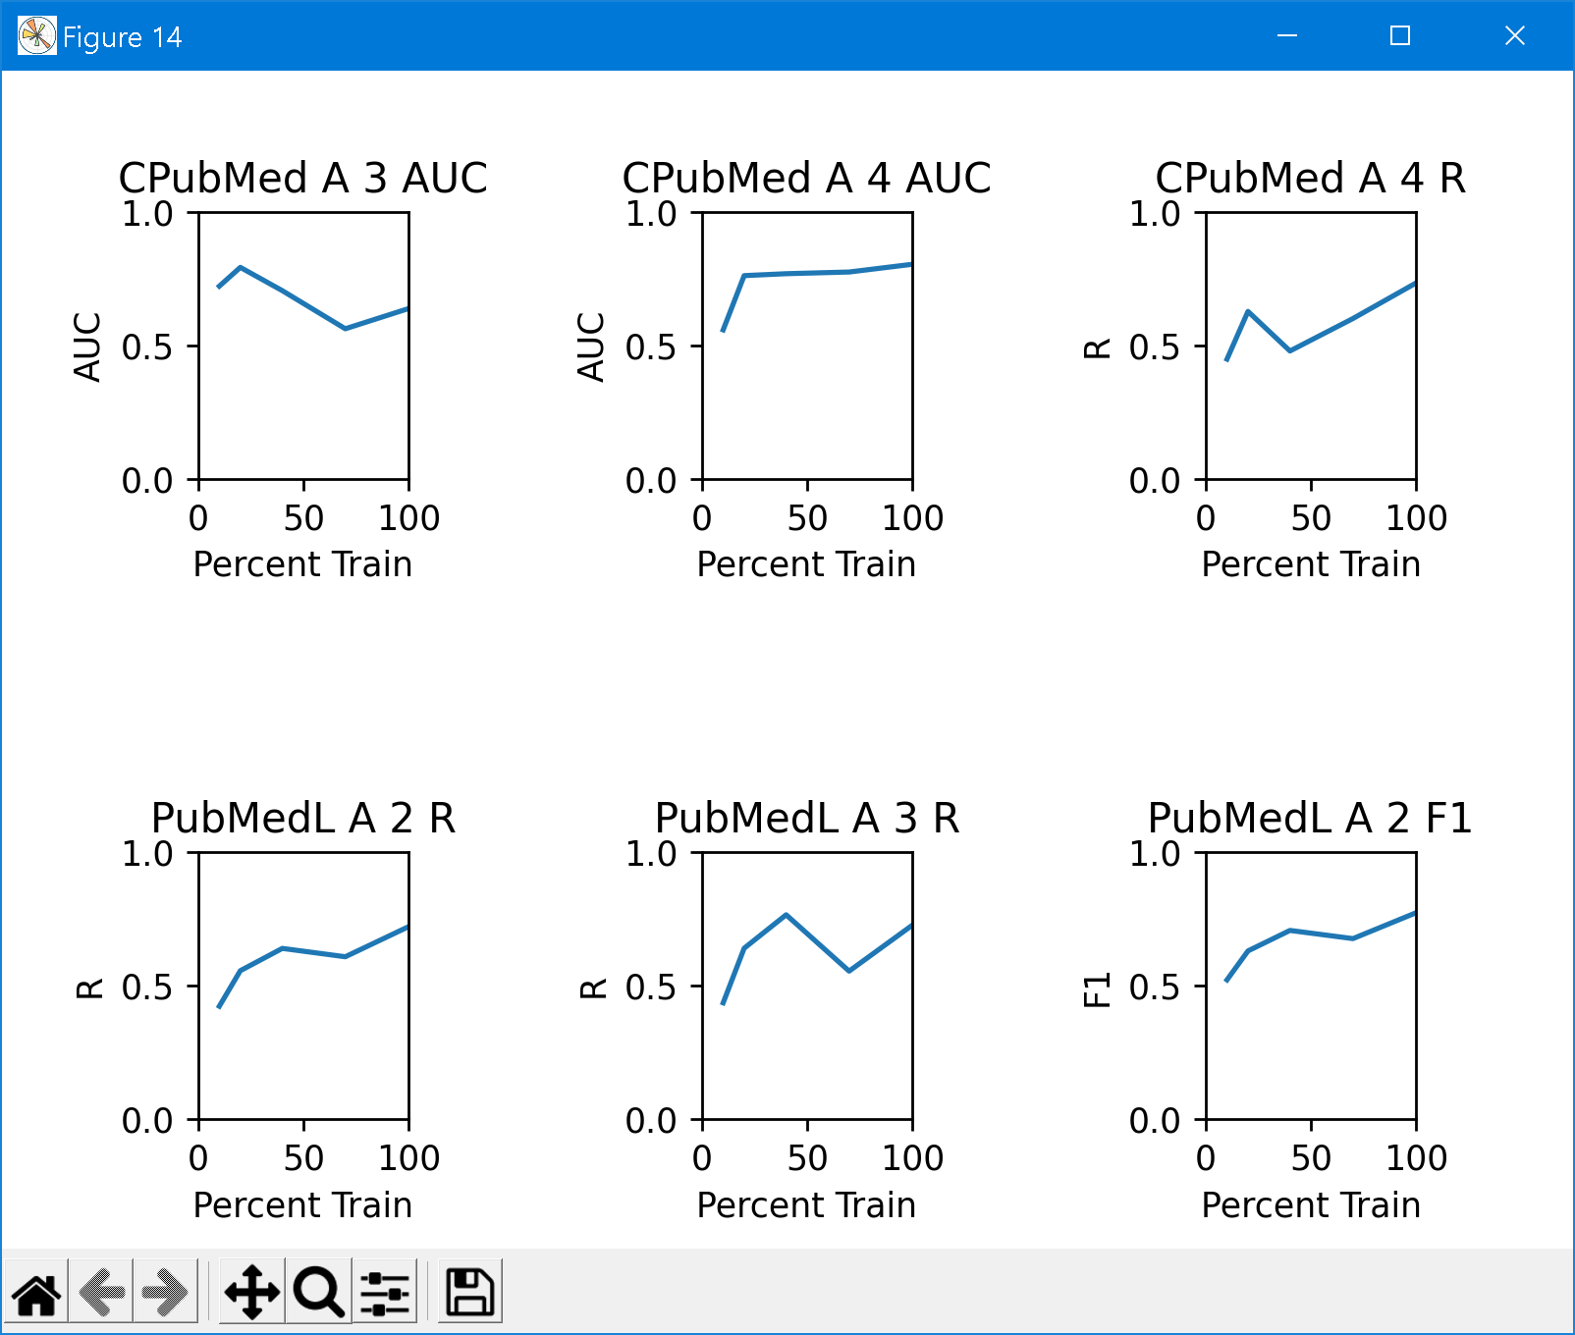
Most interesting Trends from Train Variation Experiment on an Argument by Argument Basis

Slide 10
Try to Further Improve Performance Through Semi-supervised Contrastive Learning
Idea was inspired by the observation that AMR parsing could be used to create augmented negative examples.
Involves no annotation of the titles, just running the AMR parser, and an algorithm to process the parse tree in order to produce the augmented title.
Only problem is positive examples still needed to be produced.
Solutions, use Bio Verb Net or even just plane Word Net to replace non-entity related tokens in a title with close synonyms for positive augmentation.
Also looked at the SimCSE paper, which produced in batch augmented sentences in the latent embedding space by producing embeddings for the same text twice, and performing random dropout in between.

Slide 11
Try to Further Improve Performance Through Semi-supervised Contrastive Learning
Performing drop-out in between acts as minimal positive augmentation.
So the supervised setting of the SimCSE code was used to perform contrastive pretraining of BERT.
The hope was that this would allow BERT to produce embeddings that would help DYGIE++ to learn the differences between argument types and help ensure they are classified with the correct regulation verb.
The main reason for this was based on the negative pairs which swapped the entity spans around the regulation verb so that the negative pair was an informationally nonsensical version of the original title.
Maybe if BERT can successfully separate the negative nonsense examples from the informationally correct positives in latent space more informative embeddings can be produced for entity spans.

Slide 12
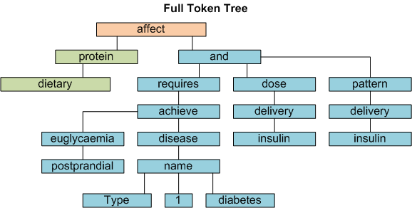
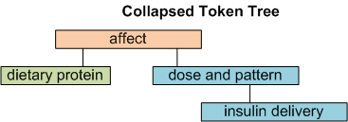

Illustration of Producing a Negative Example for Performing Contrastive Learning with PubMed Title

Slide 13
AUROC CL results
8.5k titles were used for contrastive pretraining
Contrastive pretraining was performed on all three BERT PLMs
Contrastive pretraining did not improve AUROC over all on any baseline models
model with best over all AUROC was clinical PubMed BERT base without contrastive learning
Model | Trigger AUROC | Arg1 AUROC | Arg2 AUROC | Arg3 AUROC | Arg4 AUROC | Status
PMB with CL | 0.698 | 0.756 | 0.571 | 0.595 | 0.696 | worse
PMB no CL | 0.697 | 0.810 | 0.636 | 0.659 | 0.690 | Better
PMBL with CL | 0.699 | 0.741 | 0.656 | 0.740 | 0.866 | Argument trade-off
PMBL no CL | 0.617 | 0.846 | 0.745 | 0.719 | 0.760 | Argument trade-off
CPMB with CL | 0.623 | 0.718 | 0.628 | 0.657 | 0.691 | worse
CPMB no CL | 0.762 | 0.827 | 0.675 | 0.638 | 0.804 | Better, best over all model

Slide 14
Precision CL Results
PubMed BERT large when using contrastive learning for performing further pretraining performs best on precision.
Model | Trigger Precision | Arg1 Precision | Arg2 Precision | Arg3 Precision | Arg4 Precision | Status
PMB with CL | 0.977 | 0.879 | 0.885 | 0.899 | 0.798 | worse
PMB no CL | 0.977 | 0.912 | 0.852 | 0.881 | 0.818 | better
PMBL with CL | 0.990 | 0.965 | 0.957 | 0.937 | 0.927 | Much better, best over all model by far
PMBL no CL | 0.976 | 0.898 | 0.834 | 0.853 | 0.890 | Worse than CL counter-part, but still performs well compared to others
CPMB with CL | 0.971 | 0.903 | 0.867 | 0.868 | 0.812 | Better, one of the better models
CPMB no CL | 0.969 | 0.894 | 0.851 | 0.862 | 0.775 | worse

Slide 15
Recall CL Results
PubMed BERT Large when contrastive learning is used for further pretraining achieves the best recall.
Model | Trigger Recall | Arg1 Recall | Arg2 Recall | Arg3 Recall | Arg4 Recall | Status
PMB with CL | 0.962 | 0.855 | 0.822 | 0.851 | 0.753 | A little better
PMB no CL | 0.967 | 0.887 | 0.794 | 0.828 | 0.753 | A little worse
PMBL with CL | 0.985 | 0.954 | 0.924 | 0.927 | 0.867 | Much better, best over all by far
PMBL no CL | 0.946 | 0.826 | 0.721 | 0.726 | 0.616 | Much worse
CPMB with CL | 0.954 | 0.874 | 0.799 | 0.805 | 0.688 | Argument trade-off
CPMB no CL | 0.954 | 0.861 | 0.762 | 0.805 | 0.734 | Argument trade-off

Slide 16
F1 CL Results
PubMed BERT Large performed best when contrastive learning was used for further pretraining.
Use of 24 attention layers instead of 12 might factor into this result in improved embeddings.
Model | Trigger F1 | Arg1 F1 | Arg2 F1 | Arg3 F1 | Arg4 F1 | Status
PMB with CL | 0.969 | 0.867 | 0.852 | 0.875 | 0.775 | Worse
PMB no CL | 0.972 | 0.899 | 0.821 | 0.854 | 0.784 | Better
PMBL with CL | 0.987 | 0.960 | 0.940 | 0.932 | 0.896 | Much better, best over all model
PMBL no CL | 0.961 | 0.860 | 0.773 | 0.784 | 0.728 | Much worse
CPMB with CL | 0.963 | 0.888 | 0.831 | 0.836 | 0.745 | Very slightly better
CPMB no CL | 0.961 | 0.877 | 0.804 | 0.833 | 0.754 | Very slightly worse

Slide 17
Ethical Concerns
If such a model is going to be deployed for information retrieval to support a query and inference system for research, it is probably important that the system can cite its sources in some way.
There is always still the chance that information extraction goes wrong, and people making use of the model should be able to sanity check.
Also, if at any point the PLM is used directly for producing answers to questions directly in some way similar to Chat GPT, it needs to be ensured that the model is not just spouting untruths that sound correct.
The model should probably be able to deal with a constantly evolving field of research and constantly extract or train on new information.
Research papers can be altered or retracted, and such changes need to be able to be accounted for in an ideal scenario.

Slide 18
Future Work
A possibility is to experiment with contrastive learning more by producing other patterns of span swaps, or seeing if a tool such as Chat GPT could be used in order to reword titles for better positive examples.
Need to run further experiments to see if using knowledge graphs for inference is necessary, or if a neural language model such as GPT can answer questions on Biological Mechanisms directly if pretrained in a domain of biological mechanisms or something highly related.
A text classifier needs to be trained in order to allow titles to be classified that contain extractable biological mechanisms in them.
If making use of a knowledge graph proves necessary, experiments need to be run to produce knowledge graphs from a specific biological subject such as some specific topic in immunology.

Slide 19
Acknowledgements
This work was done under the guidance of Dr. Yufei Huang at the UPMC Hillman Cancer Center, and was mentored by Jason Dou, a PHD student who works in Dr. Huang’s lab.

